Slide 1
PMCA502L – Java Programming
OOPS Concept
Java – Introduction, Classes – Objects – Methods – Constructors – this keyword – Method Overloading – Inheritance – Types – Method Overriding - super keyword – Abstract class – final keyword – Interface, Packages – predefined and User-defined, Stream based I/O and File I/O

Slide 2
Streams
The java.io package contains nearly every class you might ever need to perform input and output (I/O) in Java. All these streams represent an input source and an output destination. The stream in the java.io package supports many data such as primitives, object, localized characters, etc.
A stream can be defined as a sequence of data. There are two kinds of Streams:
InPutStream: The InputStream is used to read data from a source.
OutPutStream: The OutputStream is used for writing data to a destination.

Slide 3
Standard Streams
Java provides the following three standard streams:
Standard Input: This is used to feed the data to user's program and usually a keyboard is used as standard input stream and represented as System.in.
Standard Output: This is used to output the data produced by the user's program and usually a computer screen is used for standard output stream and represented as System.out.
Standard Error: This is used to output the error data produced by the user's program and usually a computer screen is used for standard error stream and represented as System.err.

Slide 4
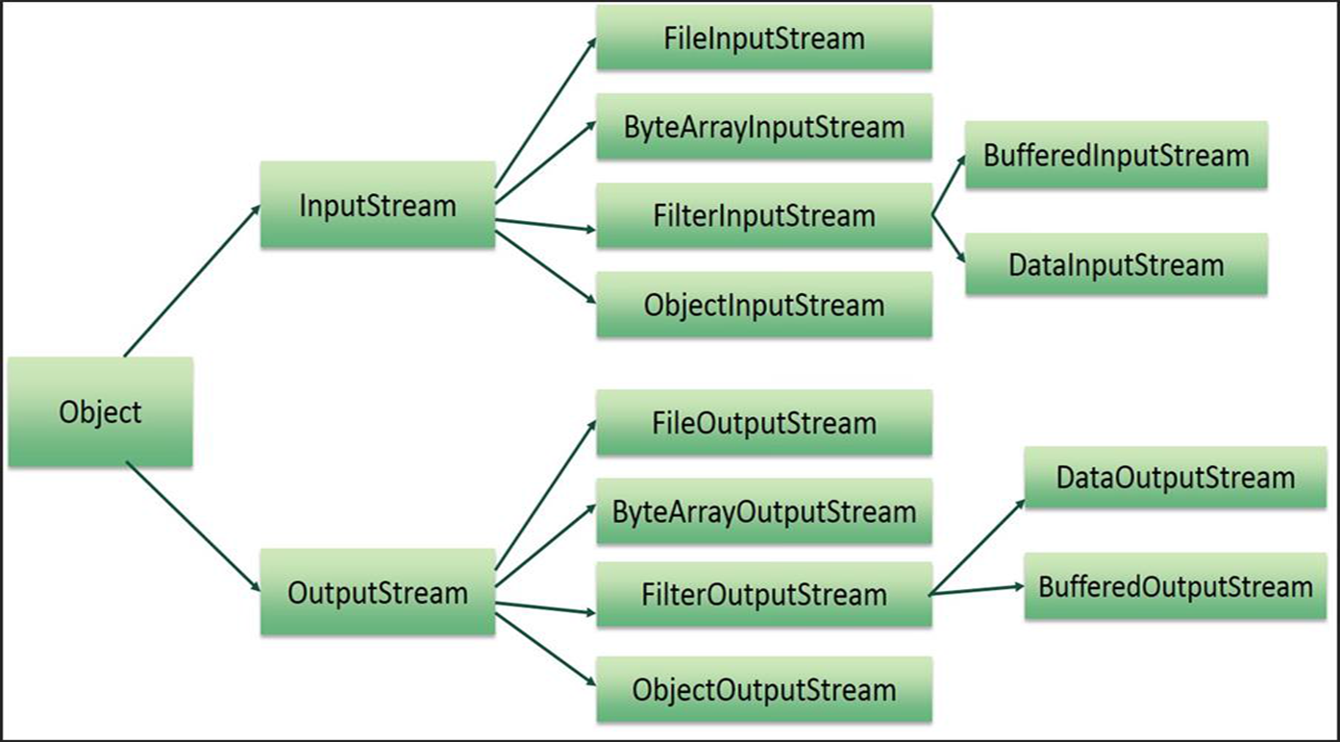
Hierarchy of Streams

Slide 5
File Class
Java File class represents the files and directory pathnames in an abstract manner. This class is used for creation of files and directories, file searching, file deletion, etc.
The File object represents the actual file/directory on the disk. Following is the list of constructors to create a File object.
File(String pathname) - This constructor creates a new File instance by converting the given pathname string into an abstract pathname.
File(File/String parent, String child) - This constructor creates a new File instance from a parent abstract pathname and a child pathname string.
File(URI uri) - This constructor creates a new File instance by converting the given file: URI into an abstract pathname.

Slide 6
File Methods
public String getName() - Returns the name of the file or directory denoted by this abstract pathname.
public String getParent() - Returns the pathname string of this abstract pathname's parent, or null if this pathname does not name a parent directory.
public String getPath() - Converts this abstract pathname into a pathname string.
public String getAbsolutePath() - Returns the absolute pathname string of this abstract pathname.
public boolean exists() - Tests whether the file or directory denoted by this abstract pathname exists. Returns true if and only if the file or directory denoted by this abstract pathname exists; false otherwise.
public long length() - The method returns length, in bytes, of the file denoted by this abstract pathname.The return value is unspecified if this pathname denotes a directory.

Slide 7
File Methods
public boolean isDirectory() - Tests whether the file denoted by this abstract pathname is a directory. Returns true if and only if the file denoted by this abstract pathname exists and is a directory; false otherwise
public Boolean isFile() - It tests whether the file denoted by this abstract pathname is a normal file.
public boolean delete() - Deletes the file or directory denoted by this abstract pathname. If this pathname denotes a directory, then the directory must be empty in order to be deleted. Returns true if and only if the file or directory is successfully deleted; false otherwise.
public String[] list() - Returns an array of strings naming the files and directories in the directory denoted by this abstract pathname.
public File[] listFiles() - Returns an array of abstract pathnames denoting the files in the directory denoted by this abstract pathname.

Slide 8
Byte Stream
Java byte streams are used to perform input and output of 8-bit bytes.
Though there are many classes related to byte streams but the most frequently used classes are, FileInputStream and FileOutputStream.

Slide 9
Character Stream
Java Byte streams are used to perform input and output of 8-bit bytes, whereas Java Character streams are used to perform input and output for 16-bit unicode. Though there are many classes related to character streams but the most frequently used classes are, FileReader and FileWriter.
Though internally FileReader uses FileInputStream and FileWriter uses FileOutputStream but here the major difference is that FileReader reads two bytes at a time and FileWriter writes two bytes at a time.

Slide 10
File Input Stream - Methods
This stream is used for reading data from the files. Objects can be created using the keyword new and there are several types of constructors available.
1. Following constructor takes a file name as a string to create an input stream object to read the file:
InputStream f = new FileInputStream("C:/java/hello");
2. Following constructor takes a file object to create an input stream object to read the file. First we create a file object using File() method as follows:
File f = new File("C:/java/hello");
InputStream f = new FileInputStream(f);

Slide 11
File Input Stream – Methods
public int read(int r)throws IOException{}
This method reads the specified byte of data from the InputStream. Returns an int. Returns the next byte of data and -1 will be returned if it's the end of the file.
public int read(byte[] r) throws IOException{}
This method reads r.length bytes from the input stream into an array. Returns the total number of bytes read. If it is the end of the file, -1 will be returned.
public int available() throws IOException{}
Gives the number of bytes that can be read from this file input stream. Returns an int.

Slide 12
File Input Stream – Methods
public void close() throws IOException{}
This method closes the file output stream. Releases any system resources associated with the file. Throws an IOException.
protected void finalize()throws IOException {}
This method cleans up the connection to the file. Ensures that the close method of this file output stream is called when there are no more references to this stream. Throws an IOException.

Slide 13
File Output Stream
FileOutputStream is used to create a file and write data into it. The stream would create a file, if it doesn't already exist, before opening it for output.
Here are two constructors which can be used to create a FileOutputStream object.
Following constructor takes a file name as a string to create an input stream object to write the file:
OutputStream f = new FileOutputStream("C:/java/hello")
Following constructor takes a file object to create an output stream object to write the file. First, we create a file object using File() method as follows:
File f = new File("C:/java/hello");
OutputStream f = new FileOutputStream(f);

Slide 14
File Output Stream – Methods
public void close() throws IOException{}
This method closes the file output stream. Releases any system resources associated with the file. Throws an IOException.
protected void finalize()throws IOException {}
This method cleans up the connection to the file. Ensures that the close method of this file output stream is called when there are no more references to this stream. Throws an IOException.
public void write(int w)throws IOException{}
This methods writes the specified byte to the output stream.
public void write(byte[] w)
Writes w.length bytes from the mentioned byte array to the OutputStream.

Slide 15
Byte Stream Write
Byte Stream Write import java.io.*;
import java.util.Scanner;
public class FileWrite2 {
public static void main(String args[]) throws IOException
{
Scanner inp = new Scanner(System.in);
System.out.println("Enter char, to end type'x'");
FileOutputStream out = new FileOutputStream("data2.txt");
int c;
do {
c=inp.next().charAt(0);
out.write(c);
} while(c != 'x');
out.close(); }
}

Slide 16
Byte Stream Read
Byte Stream - Reading
import java.io.*;
public class ByteFileDemo1{
public static void main(String [] ar) throws FileNotFoundException, IOException{
// FileInputStream fin = new FileInputStream("ThreadDemo1.java");
FileInputStream fin = new FileInputStream("data2.txt”);
System.out.println("Content of the file is..");
int c=0;
while(fin.available()>0){
c = fin.read();
System.out.print((char)c);
}
fin.close(); }
}

Slide 17
Byte Steam Write
import java.io.*; import java.util.Scanner;
public class Stream1{
public static void main(String []ar) throws IOException, FileNotFoundException{
FileOutputStream fos = new FileOutputStream("Stream1.txt");
int n,i;
Scanner inp = new Scanner(System.in);
System.out.println("How many names..");
n = inp.nextInt();
inp.nextLine();
String []name = new String[n];
System.out.println("Enter "+n+" names");
for(i=0;i<n;i++){
name[i] = inp.nextLine();
fos.write(name[i].getBytes()); }
System.out.println("Names are written into the file.."); }
}
Output:
How many Names..
4
Appu
Babu
Chitu
Tinkoo
Names are written into the file..

Slide 18
Byte Stream Read
Byte Stream - Reading
import java.io.*;
public class ByteFileDemo1{
public static void main(String [] ar) throws FileNotFoundException, IOException{
FileInputStream fin = new FileInputStream(“Stream1.txt”);
System.out.println("Content of the file is..");
int c=0;
while(fin.available()>0){
c = fin.read();
System.out.print((char)c); }
fin.close(); }
}
Output:
AppuBabuChituTinkoo

Slide 19
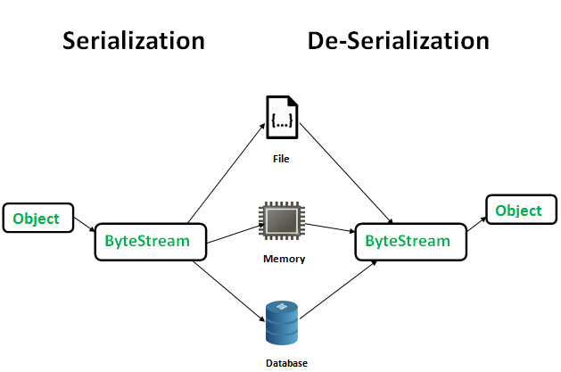
Object Serialization and Deserialization
Serialization is a mechanism of converting the state of an object into a byte stream.
Deserialization is the reverse process where the byte stream is used to recreate the actual Java object in memory. This mechanism is used to persist the object.

Slide 20
Object Serialization and Deserialization
The byte stream created is platform independent. So, the object serialized on one platform can be deserialized on a different platform.
To make a Java object serializable we implement the java.io.Serializable interface. The ObjectOutputStream class contains writeObject() method for serializing an Object.
FileOutputStream fos = new FileOutputStream(“StudentsDetails.txt”);
ObjectOutputStream oos = new ObjectOutputStream(fos);
public final void writeObject(Object Obj) throws IOException

Slide 21
Object Serialization and Deserialization
The ObjectInputStream class contains readObject() method for deserializing an object.
FileInputStream fos = new FileInputStream(“StudentsDetails.txt”);
ObjectInputStream oos = new ObjectInputStream(fos);
public final Object readObject() throws IOException
Advantages
1. To save/persist state of an object. 2. To travel an object across a network.

Slide 22
Object Serialization and Deserialization
Serializable is a marker interface (has no data member and method). It is used to “mark” java classes so that objects of these classes may get certain capability. Only the objects of those classes can be serialized which are implementing java.io.Serializable interface.
If a parent class has implemented Serializable interface then child class doesn’t need to implement it but vice-versa is not true.
Only non-static data members are saved via Serialization process.
Static data members and transient data members are not saved via Serialization process. So, if you don’t want to save value of a non-static data member then make it transient.
Constructor of object is never called when an object is deserialized.
Associated objects must be implementing Serializable interface.

Slide 23
Object Serialization and Deserialization
SerialVersionUID – The Serialization runtime associates a version number with each Serializable class called a SerialVersionUID, which is used during Deserialization to verify that sender and reciever of a serialized object have loaded classes for that object which are compatible with respect to serialization.
If the reciever has loaded a class for the object that has different UID than that of corresponding sender’s class, the Deserialization will result in an InvalidClassException. A Serializable class can declare its own UID explicitly by declaring a field name. It must be static, final and of type long.
i.e- ANY-ACCESS-MODIFIER static final long serialVersionUID=42L;
It is strongly recommended that all serializable classes explicitly declare UID value as the implicit UID is costly and complicated.
It is also recommended to use private modifier for UID since it is not useful as inherited member.

Slide 24
Object Serialization and Deserialization
In case of transient variables:- A variable defined with transient keyword is not serialized during serialization process. This variable will be initialized with default value during deserialization. (e.g: for objects it is null, for int it is 0).
In case of static Variables:- A variable defined with static keyword is not serialized during serialization process. This variable will be loaded with current value defined in the class during deserialization

Slide 25
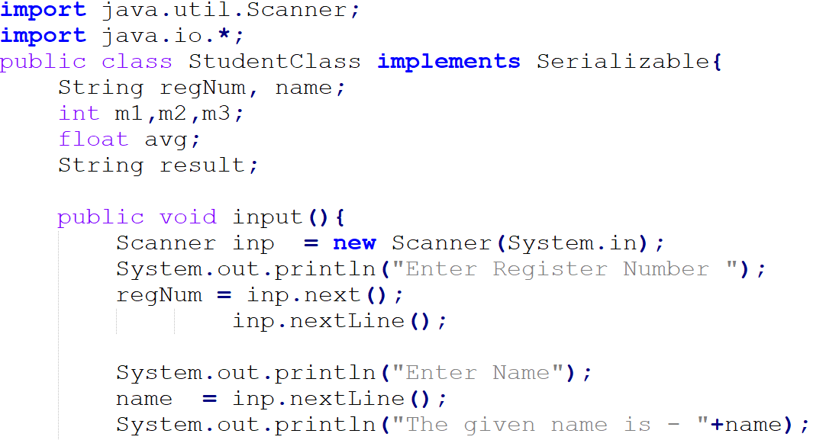
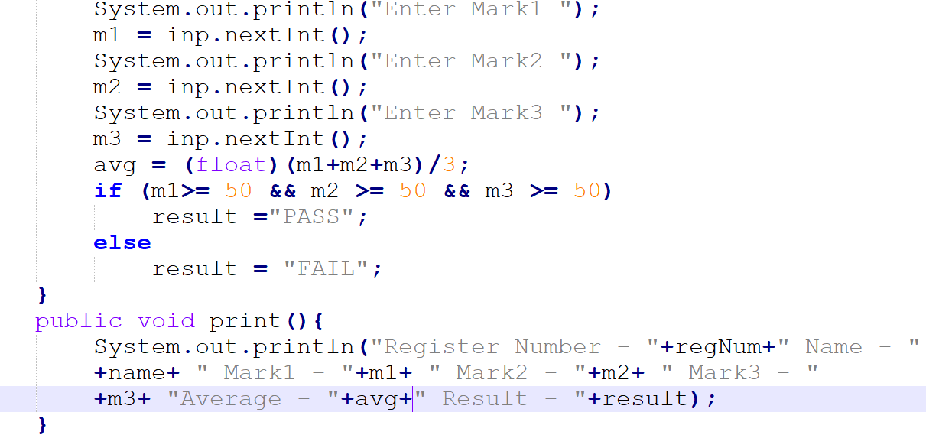
Contd.

Slide 26
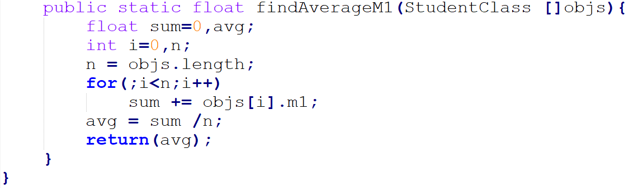
Save the above program as StudentClass.java and then compile it javac StudentClass.java (should not run as it doesn’t have main() method)

Slide 27
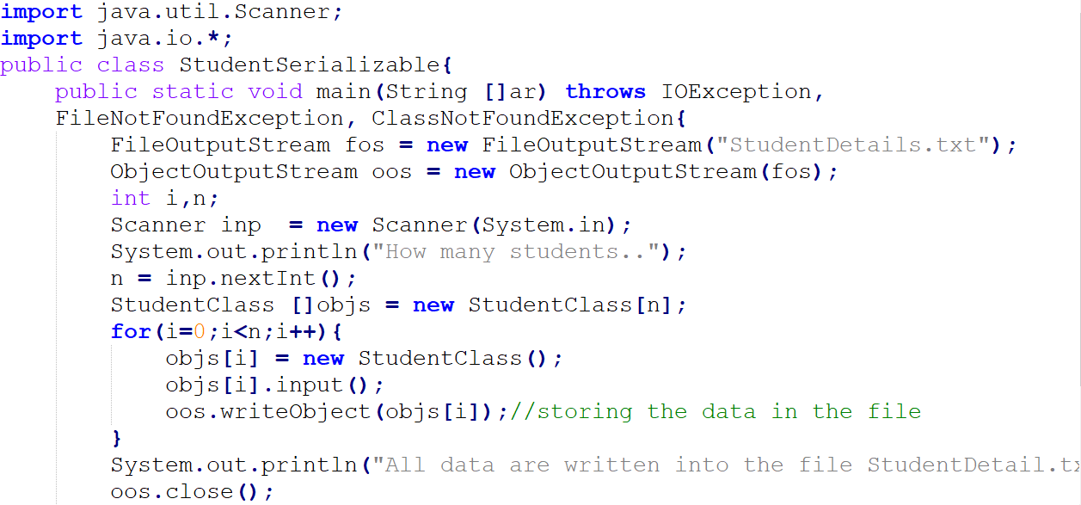

Save this program as StudentSerializable.java and then compile it javac StudentSerializable.java, and then run it as java StudentSerializable

Slide 28
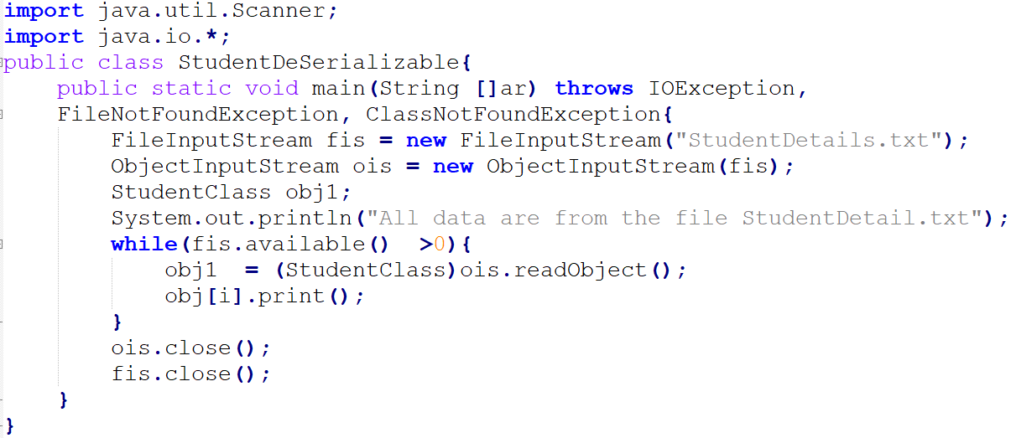
Save this program as StudentDeSerializable.java and then compile it javac StudentDeSerializable.java, and then run it as java StudentDeSerializable

Slide 29
References
www.javatpoint.com
www.tutorialspoint.com
Herbert Schildt, The Complete Reference -Java, Tata McGraw-Hill Education, Tenth Edition, 2017.
Vijayarani A., AP SITE, VIT, Vellore

